Slide 1
Backchannel with WebChat control

Slide 2
Bot Framework Channels
Skype
Slack
Facebook
Skype for Business
Cortana
Microsoft Teams
Kik
Bing

Slide 3
What happens if you just want to embed a bot in a website?
Enter WebChat
Embeddable web control
Available via CDN
Customizable
Written in TypeScript
OSS
GitHub

Slide 4
Implementing WebChat

Slide 5
Host-to-WebChat communications
Truly embedded experience
Respond to page updates
Share a data store
Guided human support

Slide 6
Behind the scenes with WebChat
Uses Direct Line
Direct communication with a registered bot
Credentials are required
Could use Direct Line to create your own channel
Access additional types of activities

Slide 7
Bot Framework activity types
message
typing
endOfConversation
event
Not all channels or clients support all activities

Slide 8
Architecture
Host
JavaScript
Direct
Line
(shared)
WebChat

Slide 9
Basic structure
WebChat ignores event activity
Add JavaScript code to host
Subscribe to event activity
Send event activities
Add code to bot to send/receive event activities

Slide 10
RxJS basics
http://reactivex.io/rxjs/
Implements the Observable pattern
LINQ for JavaScript?
Common commands
filter
Subscribe

Slide 11
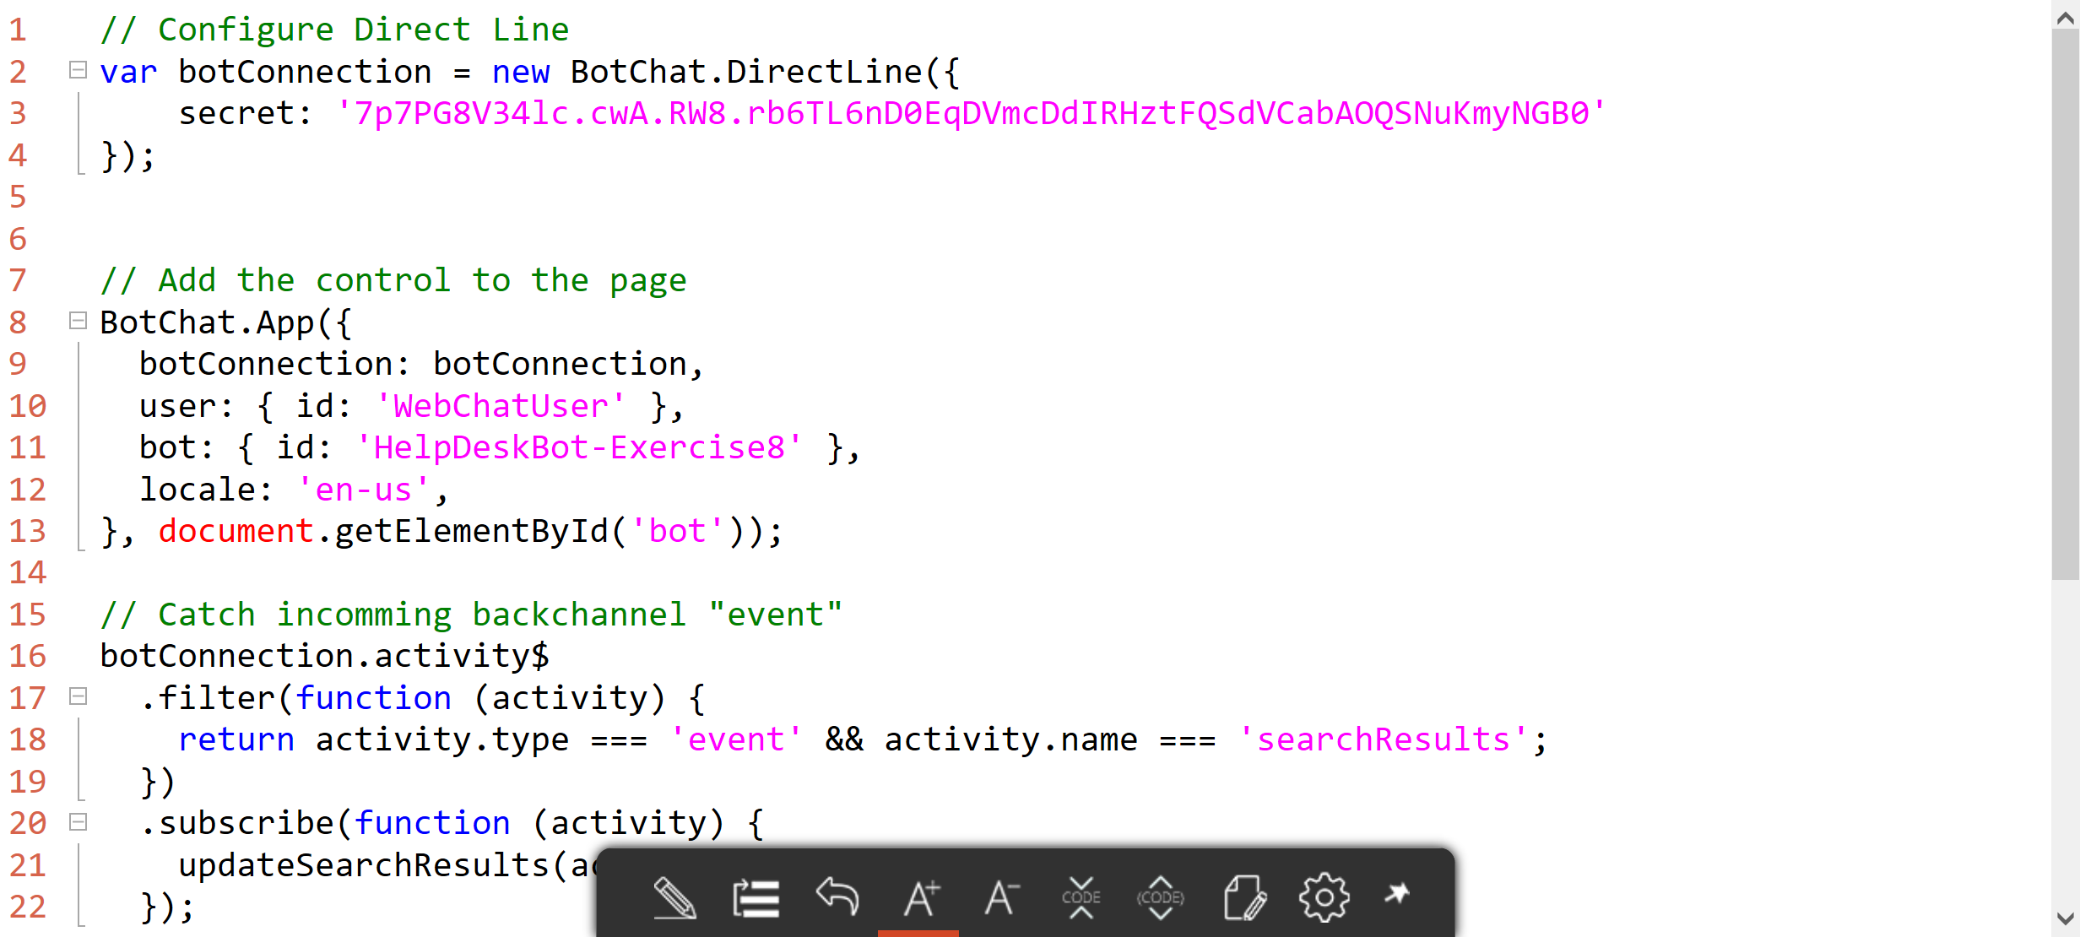
The JavaScript code

Slide 12
Bringing it all together

Slide 13
Your turn
Update your bot to:
Allow messages to be sent from a hosting web page to the user

